Slide 1
Screenshots of a prototype for LockedMe.com
As a part of phase 1 project at Simplilearn, Java FSD track
K Isaac Prasanth

Slide 2
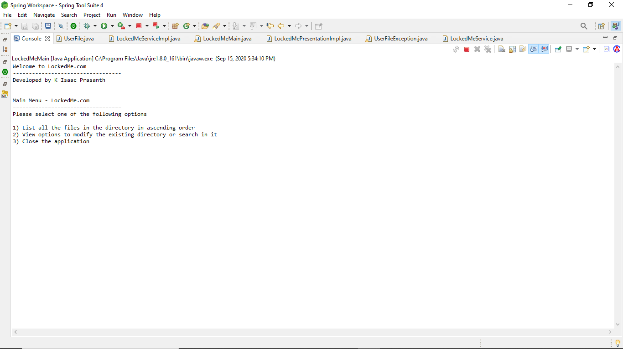
Welcome Screen of the application

Slide 3
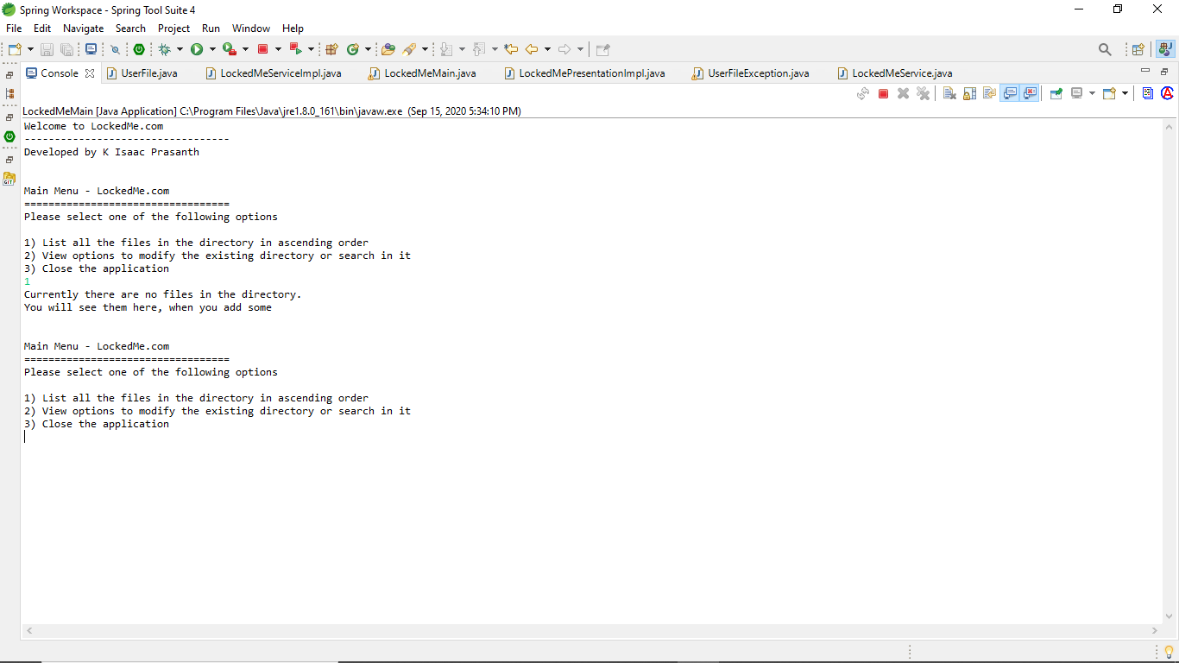
Since there are no files in the root directory, going for option 1, will return this message and show the main menu again

Slide 4
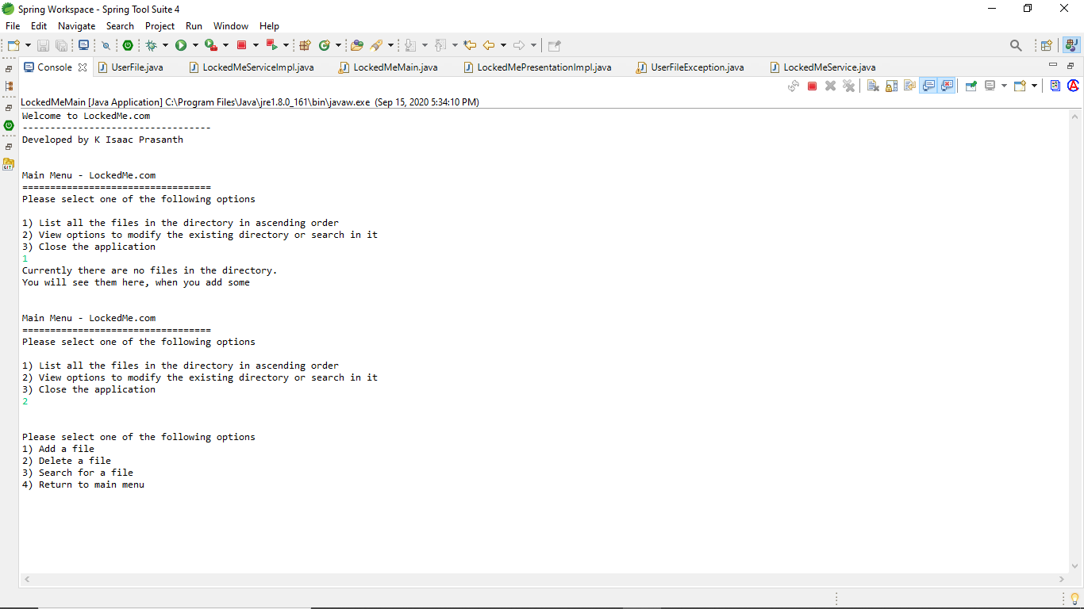
Secondary Menu, accessed by choosing option 2 in the main menu

Slide 5
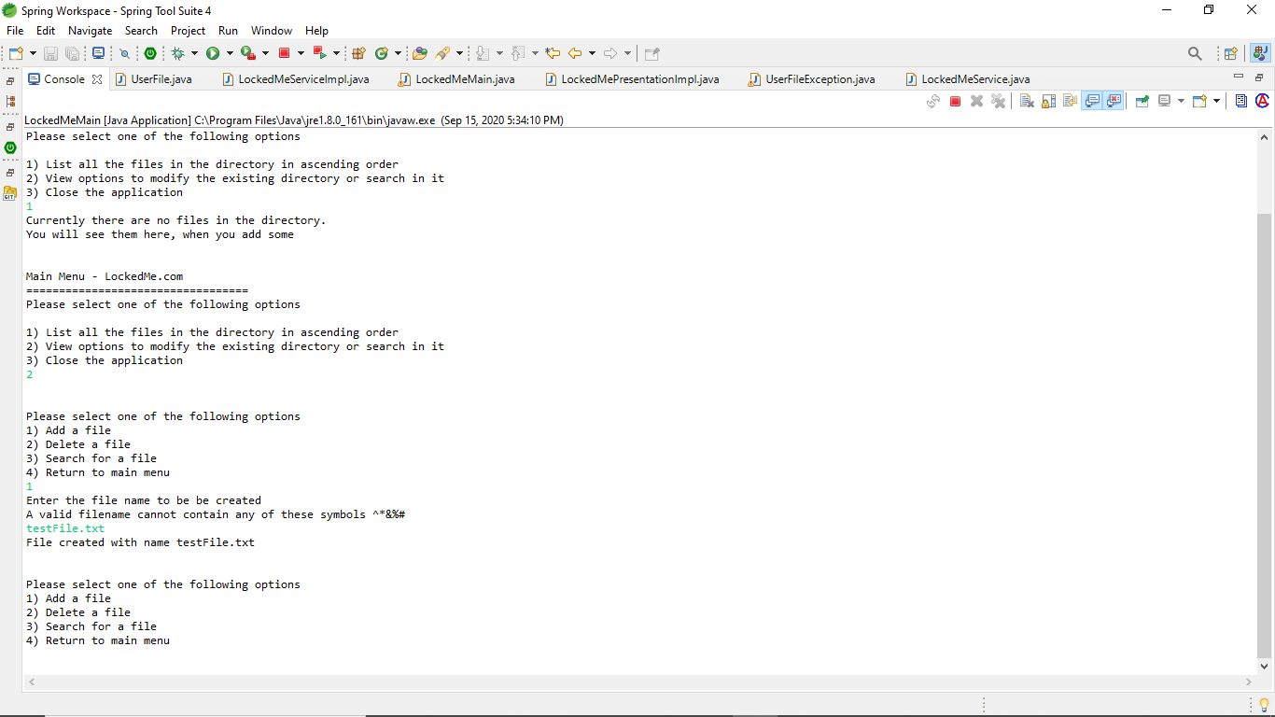
Showcasing functionality of add file

Slide 6
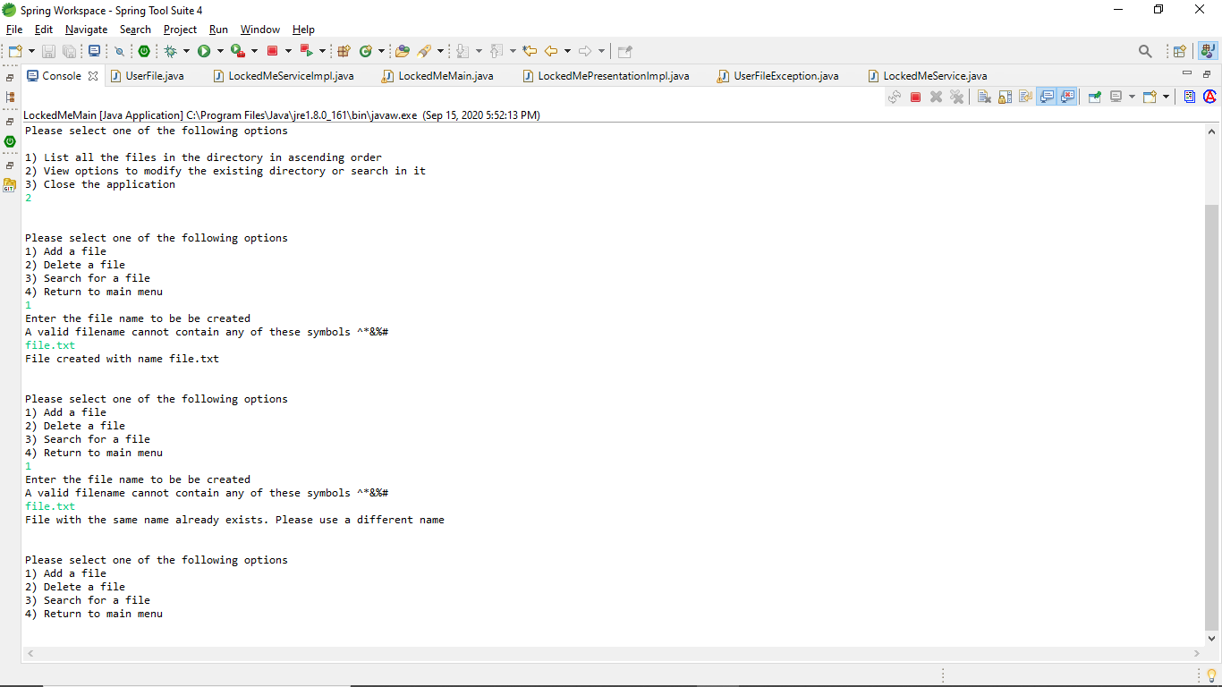
Showcasing the message on addition of a file with the same name

Slide 7
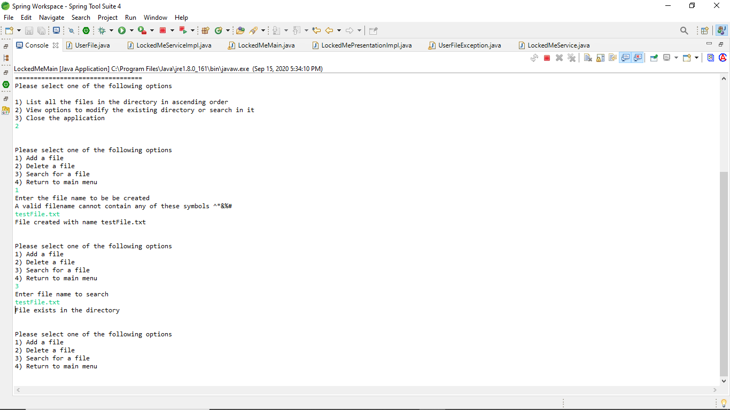
Showcasing the search functionality of the application, when the file exists.

Slide 8
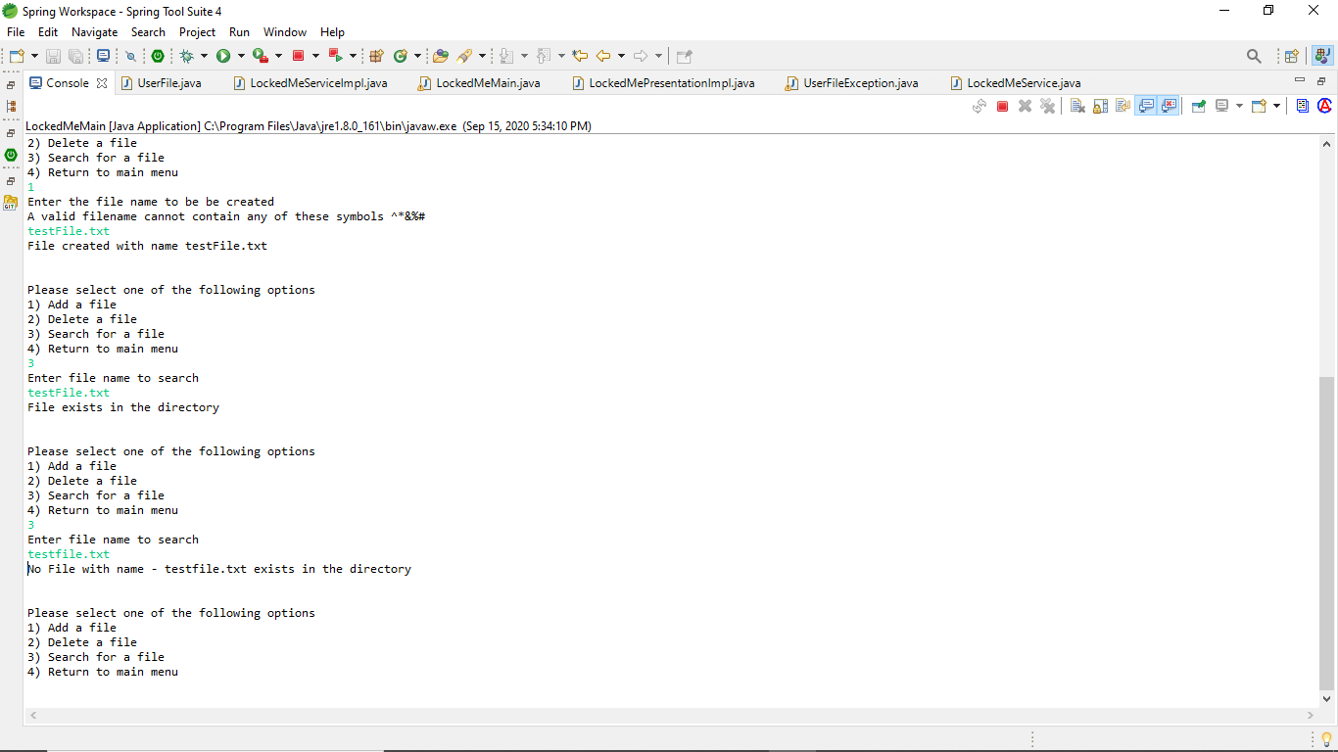
Showcasing the search functionality of the application, when the file doesn’t exist.

Slide 9
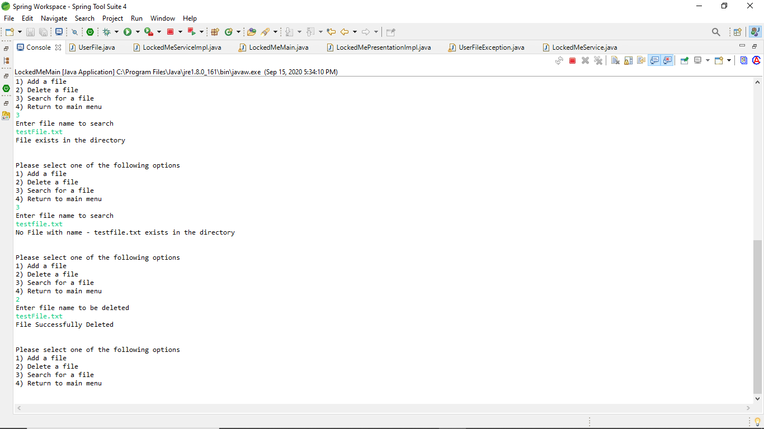
Showcasing Deletion, when the file name exists.

Slide 10
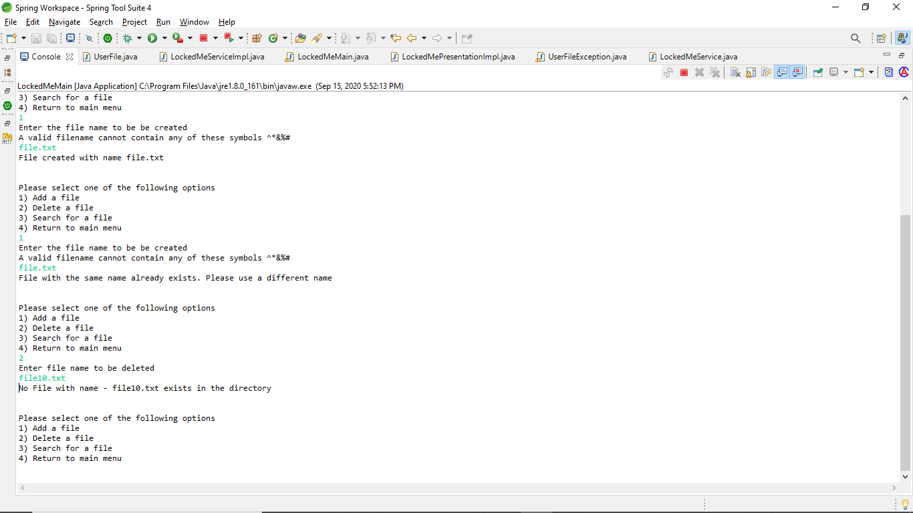
When a file name doesn’t exist and delete is called for that name

Slide 11
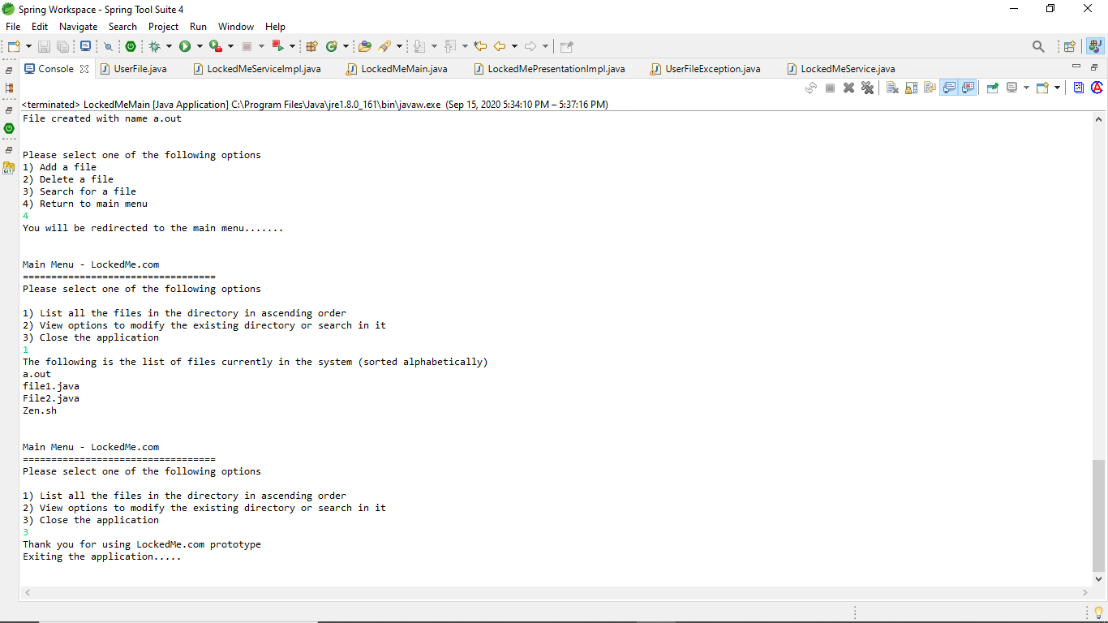
Returning to menu using the secondary menu option
Showcasing the display of the files in alphabetical order
Exit Screen

Slide 12
THANK YOU

